Slide 1

Block Size Optimization for VBASBS Queuing Model for Block Chain
Presented by Group 2:
Kyle Kentner Nathan Crosby Andrew Smith Sush Chittibabu Abdulla Karjikar

Slide 2

Introduction
Blockchain optimization -with-
Variable Bulk Arrival and Static Bulk Service Queueing Model
Notes:
This work aims to establish a theoretical model to simulate how blockchain transactions are grouped, validated, processed, and purged from a network based on a proof-of-stake consensus algorithm.

Slide 3


Methodology
Notes:
Our algorithm expands on the performance model proposed by Seol, which assumes a variable arrival rate and static processing time. It is based on a proof-of-work concept

Slide 4


Methodology
Notes:
The ethereum network has switched to a proof-of-stake consensus algorithm, allowing the block size to fluctuate based on the number of transactions.

Slide 5

Methodology
Original Performance Model
New Performance Model

Slide 6
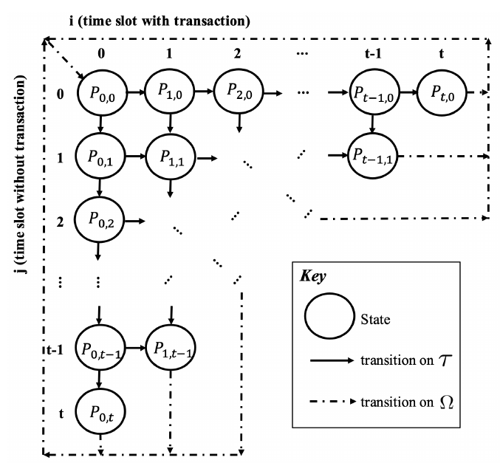
Methodology

Slide 7
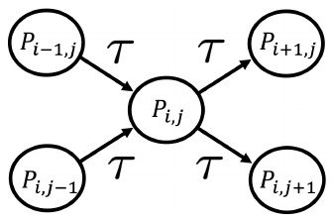
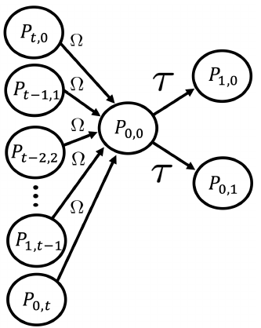
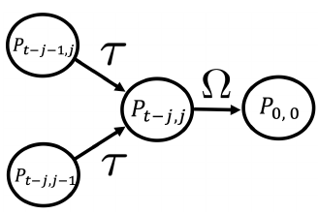
Methodology

Slide 8
Results
Python code generated plots available on github:
https://github.com/andrewqsmith/Block-Size-Optimization-for-VBASBS-Queueing-Model-for-Blockchain/tree/main/GraphCode

Slide 9
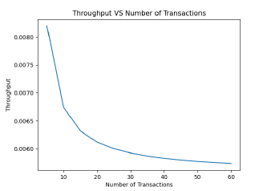
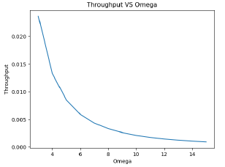
Results

Slide 10
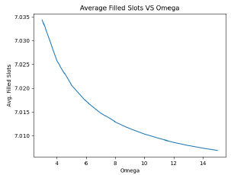
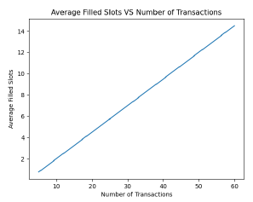
Results

Slide 11

Conclusion

Slide 12
Questions?

